Slide 1
Lecture 5
Van Der Mond Interpolation

Slide 2
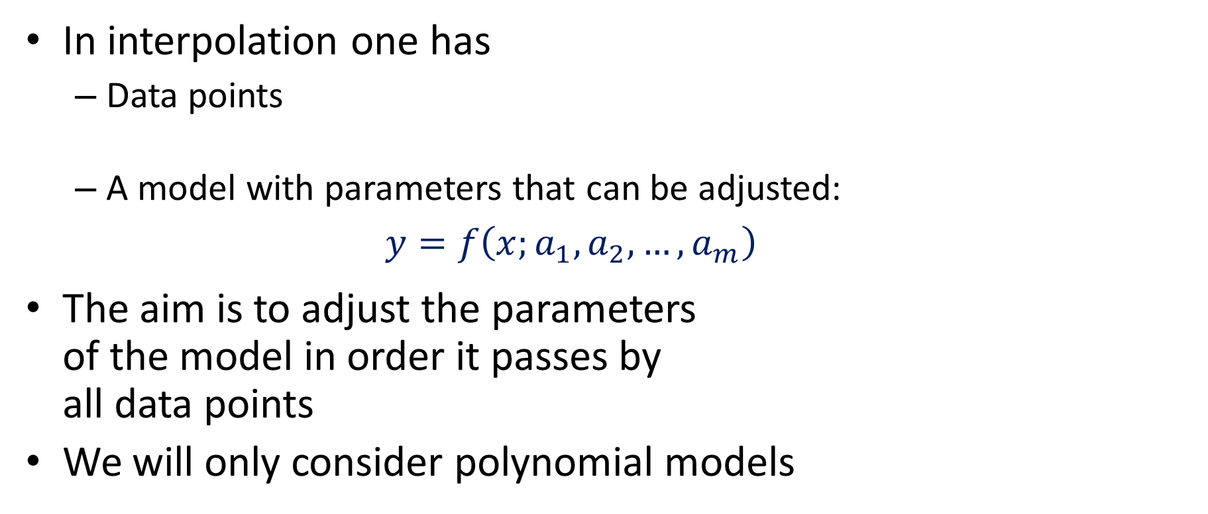


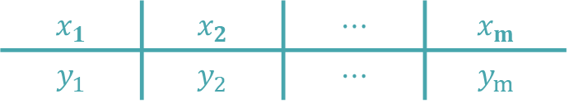
Overview of Interpolation
In interpolation one has
Data points
A model with parameters that can be adjusted: $y=f\left(x;a_{1},a_{2},…,a_{m}\right)$
The aim is to adjust the parameters of the model in order it passes by all data points
We will only consider polynomial models
$$x_{1}$$ | $$x_{2}$$ | $$⋯$$ | $$x_{m}$$
$$y_{1}$$ | $$y_{2}$$ | $$⋯$$ | $$y_{m}$$
$$y_{i}$$
$$x_{i}$$
Notes:
In this second part of the lesson we are going to discuss interpolation
As in regression we have a start point a data set and a model with parameters to be adjusted
The aim is to adjust these parameters in order to represent the data set
The difference, compared to regression, is that we have the same numbers of model parameters as data points
This means that the model will pass exactly by all data points
In this course we consider only interpolation with polynomial models

Slide 3
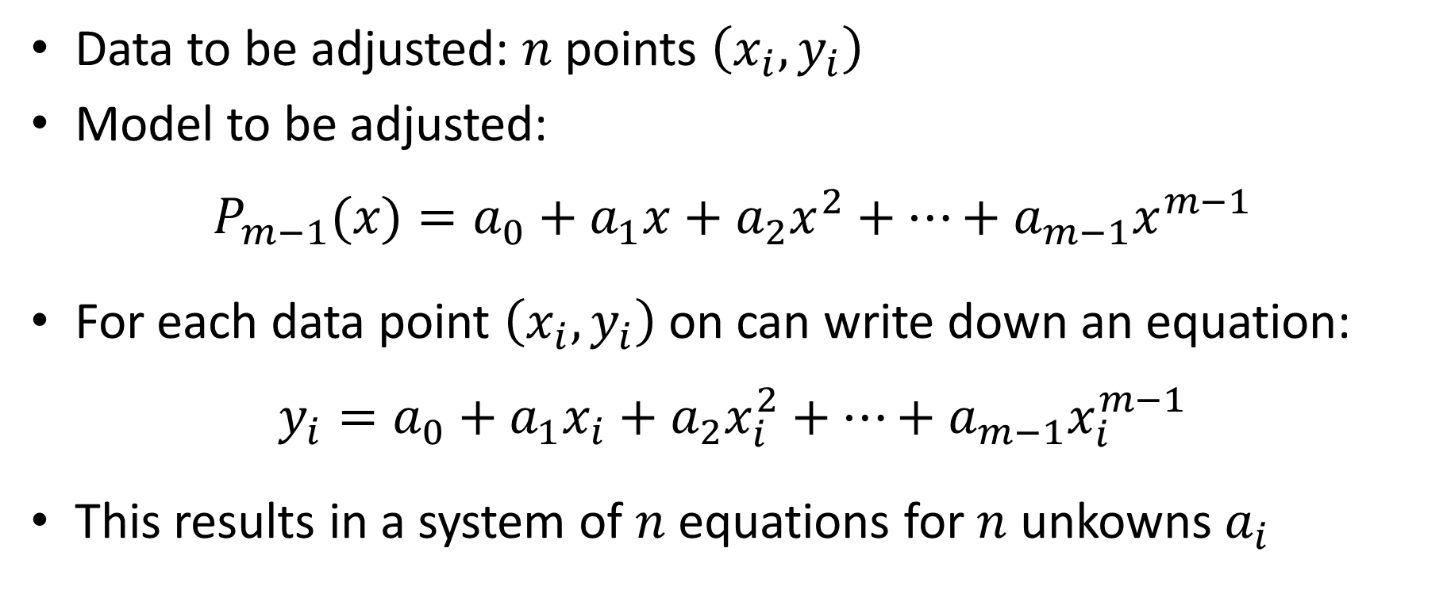
Van Der Mond Interpolation
Data to be adjusted: $n$ points $\left(x_{i},y_{i}\right)$
Model to be adjusted:
$${P_{m−1}(x)=a}_{0}+a_{1}x+a_{2}x^{2}+…+a_{m−1}x^{m−1}$$
For each data point $\left(x_{i},y_{i}\right)$ on can write down an equation:
$${y_{i}=a}_{0}+a_{1}x_{i}+a_{2}x_{i}^{2}+…+a_{m−1}x_{i}^{m−1}$$
This results in a system of $n$ equations for $n$ unkowns $a_{i}$
Notes:
In the present lecture we discuss a first method to solve the problem.
We have our m data points to which we want to adjust a polynomial model
As we have m data points, it means that we have as well exactly m model parameters ai.
This results into a polynomial of degree m-1
This polynomial is called the interpolating polynomial
We use the notation P index m-1 to indicate that the polynomial is of degree m-1
Now, for each data point, we can write an equation of the form
$${y_{i}=a}_{0}+a_{1}x_{i}+a_{2}x_{i}^{2}+…+a_{m−1}x_{i}^{m−1}$$
Writing down all these relations results in a system of m equations for m unknowns ai.

Slide 4

Van Der Mond Equations
Writing down the equations
$${y_{i}=a}_{0}+a_{1}x_{i}+a_{2}x_{i}^{2}+…+a_{m−1}x_{i}^{m−1}$$
In matrix form:
$$\left[\begin{matrix}y_{1} \\ \begin{aligned}y_{2} \\ ⋮\end{aligned} \\ y_{m}\end{matrix}\right]=\left[\begin{matrix}1 & x_{0} & x_{0}^{2} & ⋯ & x_{0}^{m−1} \\ 1 & x_{1} & x_{1}^{2} & ⋯ & x_{1}^{m−1} \\ ⋮ & ⋮ & ⋮ & & ⋮ \\ 1 & x_{m−1} & x_{m−1}^{2} & ⋯ & x_{m−1}^{m−1}\end{matrix}\right]\left[\begin{matrix}a_{0} \\ \begin{aligned}a_{1} \\ a_{2} \\ ⋮\end{aligned} \\ a_{m−1}\end{matrix}\right]$$
Van Der Mond matrix
Notes:
If we write down these equations in a matrix form, we obtain a system of linear equations with a coefficient matrix of very particular shape
The first column is made out of ones
The next one is made out of the x values of the data set
The third column is the square of these x values
The next one would be the x values power three
It goes on until the last column which is the m-1th power of the x values
Such a matrix is called a Van der Mond matrix

Slide 5

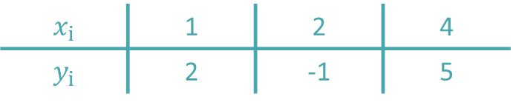
Example
Fit the following data points ($m=3$):
with the model
$${P_{2}(x)=a}_{0}+a_{1}x+a_{2}x^{2}$$
$$x_{i}$$ | 1 | 2 | 4
$$y_{i}$$ | 2 | -1 | 5
Notes:
Let us illustrate this with an example
The data set has three points
That means that the interpolating polynomial is of degree two

Slide 6

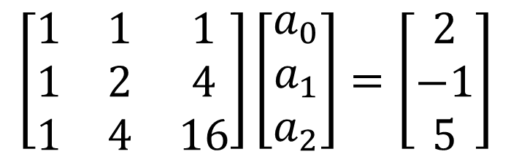
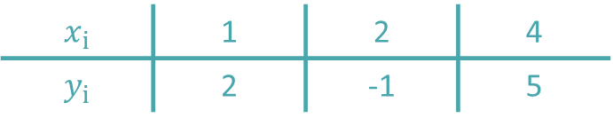
Example
Van der Mond equations:
Solving:
$$\left[\begin{matrix}a_{0} \\ a_{1} \\ a_{2}\end{matrix}\right]=\left[\begin{matrix}9 \\ −9 \\ 2\end{matrix}\right]$$
$$P_{2}(x)=9−9x+2x^{2}$$
$$\left[\begin{matrix}1 & 1 & 1 \\ 1 & 2 & 4 \\ 1 & 4 & 16\end{matrix}\right]\left[\begin{matrix}a_{0} \\ a_{1} \\ a_{2}\end{matrix}\right]=\left[\begin{matrix}2 \\ −1 \\ 5\end{matrix}\right]$$
$$x_{i}$$ | 1 | 2 | 4
$$y_{i}$$ | 2 | -1 | 5
Notes:
The first step is to write down the equations forcing the interpolating polynomial to pass exactly by each data point
This results into a Van Der Mond coefficient matrix
This matrix is straight forward to write down
Define x as the column vector of the x values form the data set.
The first column of the Van der Mond matrix is x to the power zero (which gives all one)
Second column is x to the power one
And the third column is x to the power two
Solving the resulting system of equation, gives us the model parameters
In our case, 9, -9 and 2
The interpolating polynomial is consequently $P_{2}(x)=9−9x+2x^{2}$

Slide 7



Example
$$P_{2}(x)=9−9x+2x^{2}$$
$$y$$
$$x$$
Notes:
Plotting in a graph the data points and the interpolating polynomial P2(x) confirms that P2(x) indeed passes exactly through all data points

Slide 8
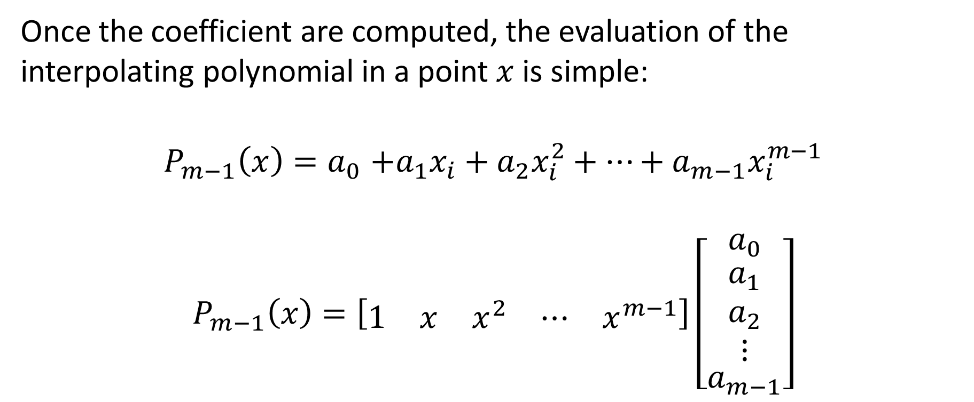
Benefit of Van Der Mond interpolation
Once the coefficient are computed, the evaluation of the interpolating polynomial in a point $x$ is simple:
$$P_{m−1}\left(x\right){=a}_{0}+a_{1}x_{i}+a_{2}x_{i}^{2}+…+a_{m−1}x_{i}^{m−1}$$
$$P_{m−1}\left(x\right)=\left[\begin{matrix}1 & x & x^{2} & ⋯ & x^{m−1}\end{matrix}\right]\left[\begin{matrix}a_{0} \\ \begin{aligned}a_{1} \\ a_{2} \\ ⋮\end{aligned} \\ a_{m−1}\end{matrix}\right]$$
Notes:
A benefit of the Van der Mond approach to interpolation is that the interpolating polynomial can quickly be evaluated in any point x
Indeed, the polynomial Pn-1(x) can be written as the product between the row vector [1 x x^2 etc until x power m-1]
and the column vector made out of the model parameters

Slide 9
Drawback of Van Der Mond interpolation
The resulting system of equation is not a straight forward system (e.g. upper diagonal) to be solved
The Vand Der Mond matrix has a high conditioning number making the solution process sensitive to round-off errors
Notes:
On the negative side, when using the Van der Mond approach we do not find a system of equation that is fast to solve (such as a upper diagonal system for example)
Further, it turns out that a Van Der Mond matrix has usually a relatively high conditioning number
That means that calculating the model parameters by solving the Van Der Mond equation is sensitive to round-off errors

Slide 10


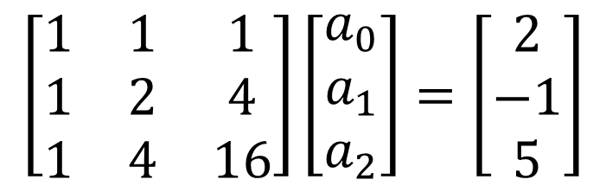
Example
In our example we found
Interpolating in $x=5$:
$$P_{2}\left(x=5\right)=\left[\begin{matrix}1 & 5 & 25\end{matrix}\right]\left[\begin{matrix}9 \\ \begin{aligned}−9 \\ 2\end{aligned}\end{matrix}\right]=9−45+50=14$$
$$\left[\begin{matrix}1 & 1 & 1 \\ 1 & 2 & 4 \\ 1 & 4 & 16\end{matrix}\right]\left[\begin{matrix}a_{0} \\ a_{1} \\ a_{2}\end{matrix}\right]=\left[\begin{matrix}2 \\ −1 \\ 5\end{matrix}\right]$$
$$\left[\begin{matrix}a_{0} \\ a_{1} \\ a_{2}\end{matrix}\right]=\left[\begin{matrix}9 \\ −9 \\ 2\end{matrix}\right]$$
Notes:
Let us go back to our example to illustrate these remarks
Recall that we found the model parameters 9, -9 and 2 by solving the Van der Mond equation
If we want to evaluate out interpolating polynomial in the value x=5, we can do this by simply computing the product between the row vector 1 5 25 and the column vector 9, -9 2.
We find the value 14

Slide 11
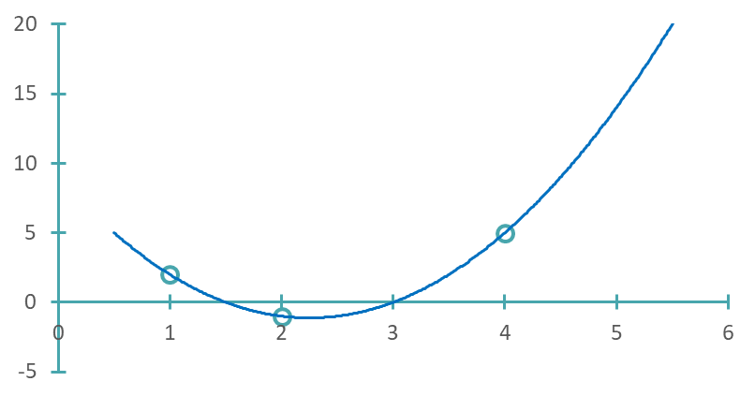



Example
$$P_{2}(x)=9−9x+2x^{2}$$
$$y$$
$$x$$
Notes:
From the graph of the interpolating polynomial we confirm that the point (x=5, y=14) is indeed on y=P2(x)

Slide 12
Example – Using Octave
octave> x=[1 2 4]'; y=[2 -1 5]';
octave> A=[x.^0 x.^1 x.^2]
A =
1 1 1
1 2 4
1 4 16
octave> a=A\y
a =
9.0000
-9.0000
2.0000
octave> [1 5 25]*a
ans = 14.000
octave> format long
octave> [1 5 25]*a
ans = 14.00000000000001
octave> a
a =
9.000000000000002
-9.000000000000002
2.000000000000000
octave> cond(A,inf)
ans = 105
Notes:
The same calculations can be done efficiently with octave
We start by entering the column vectors x and y of our data set
Then we build the van der Mond matrix by calculating each column of it
To find the model parameters we have to solve the stem of equation which we do here by PA=LU decomposition
We can as well easily evaluate the interpolating polynomial in any point x
For example for x=5 we compute the product between the row vector [1 5 25] and the model parameter vector a
Octave finds the value 14
Let us repeat this last calculation but by forcing to display all used digits with the command format long
We realize that octave doesn’t find exactly 14, but a number very close to 14
As well, for the model parameters octave doesn’t in fact find 9, -9 and 2. But rather some numbers very close to it
The reason is the conditioning number of the coefficient matrix A
In our case it is 105, which means that lose typically 2 digits when solving the Van der Mond equations
This explains why we don’t find exactly the expected values

Slide 13
Summary
Van Der Mond interpolation allows to compute an interpolating polynomial to a given data set
It is well suited for implementation in Matlab/Octave
The major drawback is however the usually high conditioning number of the system to be solved, making the method sensitive to round-off errors
Notes:
Let us summarize the key findings
Van Der Mond interpolation allows to compute an interpolating polynomial to a given data set
It is well suited for implementation in Matlab/Octave
The major drawback is however the usually high conditioning number of the system to be solved making, the method sensitive to round-off errors

